Slide 1
Air Quality Analysis in the United States
Thomas Nguyen
CS 591 Data Mining

Slide 2
Project Idea
Goal: Analyze air quality differences across the United States in terms of emission. Examine the trends in air quality over time.
Collected from EPA air data from 1990 to 2014 from the EPA official website.
http://aqsdr1.epa.gov/aqsweb/aqstmp/airdata/download_files.html

Slide 3
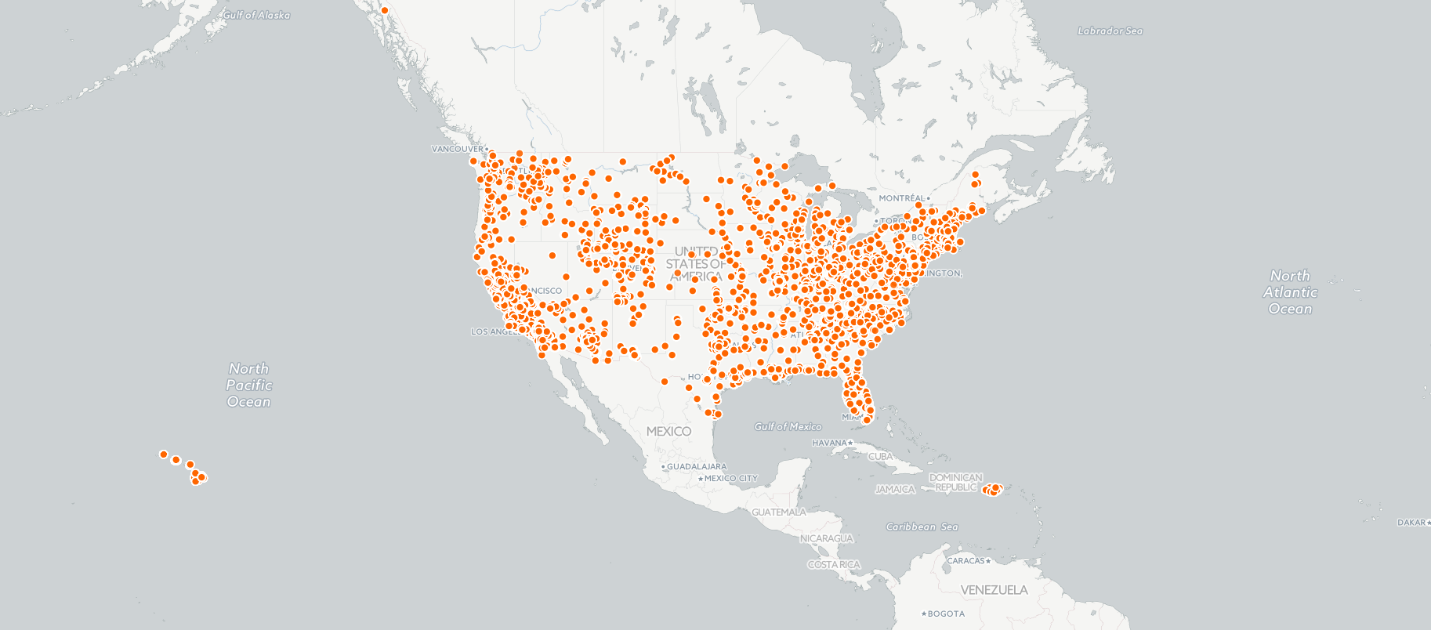
Map of All Air Quality Recording Sites

Slide 4
Hypothesis
I believe that air quality in the United States has improved over time across all pollutant emissions.
Sites with most pollutants will be around large cities / states with a lot of buildings and factories (New York, California, etc.).
Air pollutant levels will decrease in future years.

Slide 5
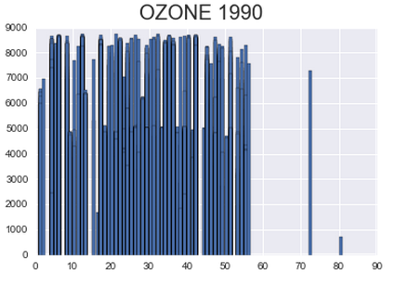
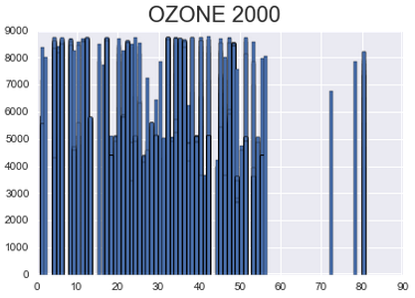
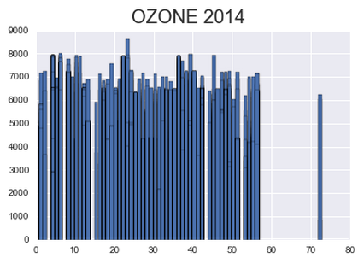
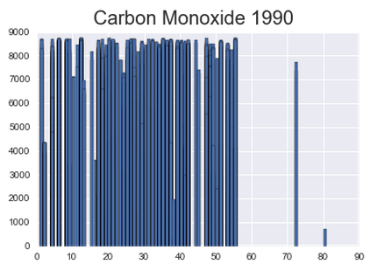
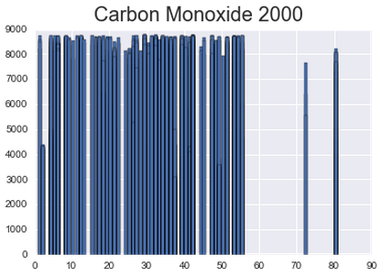
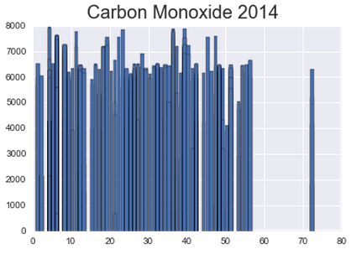
Pollutants over time
Mean: 6539 ppm. STD: 1888.39 ppm
Mean: 6251 ppm. STD: 1911.45 ppm
Mean: 5538 ppm. STD: 1443.48 ppm
Mean: 7491 ppm. STD: 1899.87 ppm
Mean: 7666 ppm. STD: 1738.90 ppm
Mean: 5386 ppm. STD: 1874.52 ppm

Slide 6
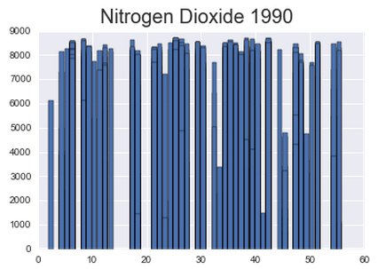
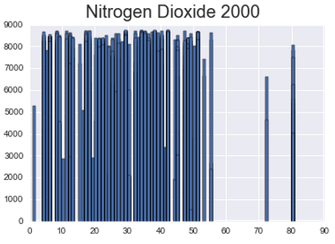
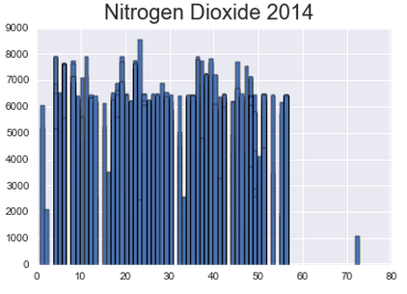
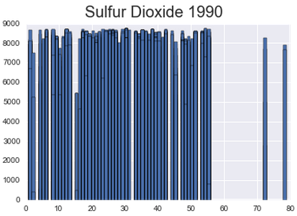
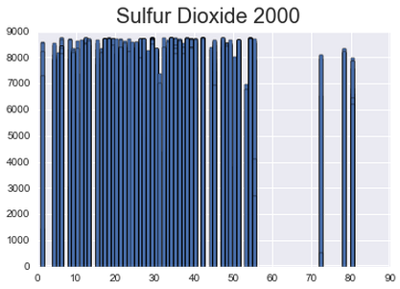
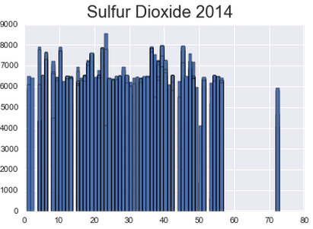
Pollutants over time
Mean: 7016 ppm. STD: 2187.81 ppm
Mean: 7391 ppm. STD: 1908.89 ppm
Mean: 5530 ppm. STD: 1757.17 ppm
Mean: 7532 ppm. STD: 1710.41 ppm
Mean: 7905 ppm. STD: 1550.90 ppm
Mean: 6226 ppm. STD: 1273.18 ppm

Slide 7
Percent Reductions Over Time
Pollutant | 1990 vs. 2014 | 2000 vs. 2014
Carbon Monoxide | -76% | -59%
Ozone | -23% | -18%
Sulfur Dioxide | -46% | -29%
Nitrogen Dioxide | -76% | -62%
Analysis was run not only on average values of 1990, 2000, and 2014 but for all years (1990-2014).

Slide 8
States with Top Emissions in 2014
Carbon Monoxide: Arizona (7938), New York (7889), Ohio (7879), District of Columbia (7765)
Ozone: California (8004), Ohio (7976), Arizona (7941)
Nitrogen Dioxide: Arizona (7915), District of Columbia (7897), California (7739)
Sulfur Dioxide: Ohio (7958), South Carolina (7954)

Slide 9
Trends and Extrapolation
Future carbon monoxide, ozone, and nitrogen dioxide pollutant levels will continue to decrease according to linear regression analysis of current levels. Sulfur dioxide levels will remain relatively unchanged.
Cities/States that currently emit the most pollutants have consistently done so for the last 24 years and show the most improvement over time.
Air quality in general will be better in future years in regards to the main pollutants analyzed (CO, Ozone, NO₂, SO₂).

